Slide 1

August 2024 Non-Public School Tabletop Exercise
Facilitator Briefing
Monday, July 29, 2024
Notes:
Facilitator: Kate/Kim

Slide 2

Welcome and Introductions
Notes:
Facilitator: Kate/Kim

Slide 3
Agenda for Today
Welcome & Introductions
Exercise Overview & Facilitator Lead Role
Scenario Modules & Facilitator Questions
Exercise Summary, Admin, & Logistics
Questions and Adjourn
Notes:
Facilitator: Kim

Slide 4
Program Overview
MCSS has conducted three exercises and workshops over the last year to promote preparedness and ensure effective response in the State of Maryland during a school-based emergency.
Comprehensive Emergency Management Plan
Integrated Preparedness Planning Workshop and Plan
State Agency School-Based Incident Tabletop Exercise
Statewide Public School System Live Stream Exercise
Non-Public School Live Stream Exercise
Notes:
Kim

Slide 5





Tabletop Exercise (TTX)
What is a TTX?
A TTX is a discussion-based exercise where participants can use existing emergency plans to discuss response to a scenario in a no-fault environment.
How will it work?
All participants will complete the TTX in a hybrid environment:
Each school will gather, in person, with their invited stakeholders/leadership.
MCSS will live stream the scenario to schools.
MCSS will describe the scenario and then pause for in-person discussion.
After in-person discussion, all participants will conduct a group brief out on the live stream to learn from one another.
School A
School D
School B
School C
Notes:
Emma

Slide 6
Exercise Purpose:
To facilitate internal, on-site discussion that promotes preparedness in non-public schools.
Intended Outcomes:
Support participants in testing existing plans, or identifying areas for future emergency planning
Socialize existing state supports available to non-public schools
Identify non-public school-specific capabilities and needs during emergencies
Notes:
Facilitator: Emma

Slide 7
Exercise Objectives
Help non-public schools to evaluate the effectiveness in responding to and recovering from a significant incident.
Internally identify capabilities and gaps in order to improve plans.
Understand resource and assistance needs in non-public schools, and the ability of the state and other stakeholders to provide support.
Notes:
Facilitator: Emma

Slide 8
Exercise Ground Rules
Short discussion after both module among local groups.
No “right” answers - discuss all options.
Test the plan(s).
Accept the artificialities of the scenario.
Make notes on your responses and be prepared to brief-out to the larger group.
This is a self evaluation opportunity for the school.
Notes:
Facilitator: Emma
Note to the group MCSS will review the ground rules during the exercise livestream introduction for the all schools

Slide 9
Exercise Agenda
Time | Activity
12:45 | Meeting room open, tech checks
1:00-1:15 | Opening remarks, MCSS introductions,
1:15-1:30 | Exercise purpose, overview, instructions
1:30-2:00 | Module 1 (30 minutes)
1:30-1:35 | Scenario update
1:35-1:50 | School Discussion
1:50-2:00 | Brief Out
2:00-2:45 | Module 2 (45 minutes)
2:00-2:05 | Scenario update
2:05-2:30 | School Discussion
2:30-2:45 | Brief Out
2:45 | End Exercise
2:45-3:00 | Conclusion, Closing Remarks, Next Steps
Notes:
Facilitator: Emma

Slide 10




Exercise Rhythm
  Scenario Introduction (MCSS Live Stream)
      Breakout: Local Group Discussion
      Brief-out with all groups
    Scenario Update (MCSS Live Stream)
        Breakout: Local Group Discussion
        Brief-out with all groups
  Scenario Introduction (MCSS Live Stream)
      Breakout: Local Group Discussion
Notes:
Facilitator: Emma
Everyone will be at their sites and MCSS will facilitate the first module (explain the scenario)
We then will pause, each school can turn off their cameras, mute their mics, and the facilitator can facilitate a candid conversation.
After the 15 minutes elapses you will turn cameras back on and participate in the Google Meet (in breakout groups, due the number of schools that have registered) and a few schools will be selected to brief out; we ask that all facilitator’s be prepared to brief out.
Then the Scenario update will be provided and the same process is repeated
Turn off cameras and mute mics, have a 20 minute discussion
When time is up, turn everything back on, brief out

Slide 11
The Facilitator’s Role
Before the TTX
During the TTX
Ensure the right players in your school are invited
Identify key locations for the scenario
Review facilitator materials
Identify a notetaker
Coordinate the space and video conference equipment
Facilitate on-site discussion
Be prepared to brief-out to the larger group
Notes:
Facilitator: Emma

Slide 12
Scenario
Notes:
Facilitator: Steve

Slide 13

Scenario Introduction: Tornado Watch
Today is Thursday, September 26th. It is a half-day with an early dismissal (12:30 p.m.). Staff have afternoon onsite professional development.
Heavy rain and thunderstorms have been blanketing the area all morning.
11:00 am: The National Weather Service and local weather stations issue a tornado watch for the region.

Slide 14
Module 1: Facilitator Questions:
What preparations does your school make prior to the expected severe weather?
How does your school receive information about weather-related threats?
  Who is responsible for monitoring these alerts?
What systems are available that can facilitate information sharing and coordination among your school and relevant stakeholders?
What guidance does your school expect from local or state authorities?

Slide 15
Optional Facilitator Questions
How does the incoming storm change your school’s operations?
    Is there sufficient information to warrant a change in the current normal operating status?
    Would any emergency operations or other plans be initiated or reviewed at this time?
    Who would make this decision, and how would it be communicated?
    Are there external stakeholders who should be notified if you have enacted a change in your school’s operating status?
    Are parents notified?
        If so, how are they notified?
Are there any messages or communications from your city, county, neighboring counties, or state that your school would be monitoring?
Would your school choose to communicate with staff about this impending storm?
    Does your plan outline communication procedures?
    With whom would you communicate at this time (e.g., senior staff only, supervisors, all staff, others)?
    How would communications be disseminated? Are there any technology redundancies?
    Does your school have pre-determined messaging for this kind of event?

Slide 16

Scenario Update: Tornado Warning
11:45 am: The National Weather Service and local weather stations have upgraded their weather forecast and have now issued a tornado warning until 12:20 pm. The school immediately takes action to ensure student safety.
11:50 am: The school begins to receive calls from concerned parents on what they should do. Some parents are enroute to the school or already in the parking lot. Two buses are also onsite for the early dismissal.

Slide 17
Scenario Update: Tornado Warning
12:05 pm: Staff report a loud train noise passing. Students remain in a secure location while it is confirmed the storm has passed. No students or staff are injured.
12:15 pm: Staff confirm the school building is secure, but a satellite location (portable, gym, or wing of the building) has sustained damage to the roof.
12:30 pm: Students are safely dismissed for the day. Some students’ transportation is late due to debris in the roads.
1:30 pm: It is confirmed that the damaged location will require repair.

Slide 18
Module 2: Facilitator Questions
What actions would this updated information prompt, if any?
What information are you sharing within the school?
  To whom will this information be disseminated, and how will it be delivered?
  How are you coordinating with transportation providers outside of your county?
Who are you contacting outside of the school (first responders, parents, state resources, organization/enterprise POCs)?
Would your school activate an emergency plan at this time?
  What would trigger activation?

Slide 19
Optional Facilitator Questions
Would school administration consider releasing students and teachers early or in a different manner?
  How much time ahead of an event like this would be required for adequate dismissal?
  What is the best way for school leadership to communicate an early dismissal to staff? What are the current protocols, expectations, and mechanisms for this instance?
  How would your school handle individual requests for early release?
    How are these early releases approved, communicated up the chain, or tracked?
What information from the city, county, or state might automatically trigger your school to activate your emergency operations plan?
What factors would impact your decision to close school?
Notes:
Steve

Slide 20
Exercise Agenda
Time | Activity
12:45 | Meeting room open, tech checks
1:00-1:15 | Opening remarks, MCSS introductions,
1:15-1:30 | Exercise purpose, overview, instructions
1:30-2:00 | Module 1 (30 minutes)
1:30-1:35 | Scenario update
1:35-1:50 | School Discussion
1:50-2:00 | Brief Out
2:00-2:45 | Module 2 (45 minutes)
2:00-2:05 | Scenario update
2:05-2:30 | School Discussion
2:30-2:45 | Brief Out
2:45 | End Exercise
2:45-3:00 | Conclusion, Closing Remarks, Next Steps
Notes:
Facilitator: Steve

Slide 21
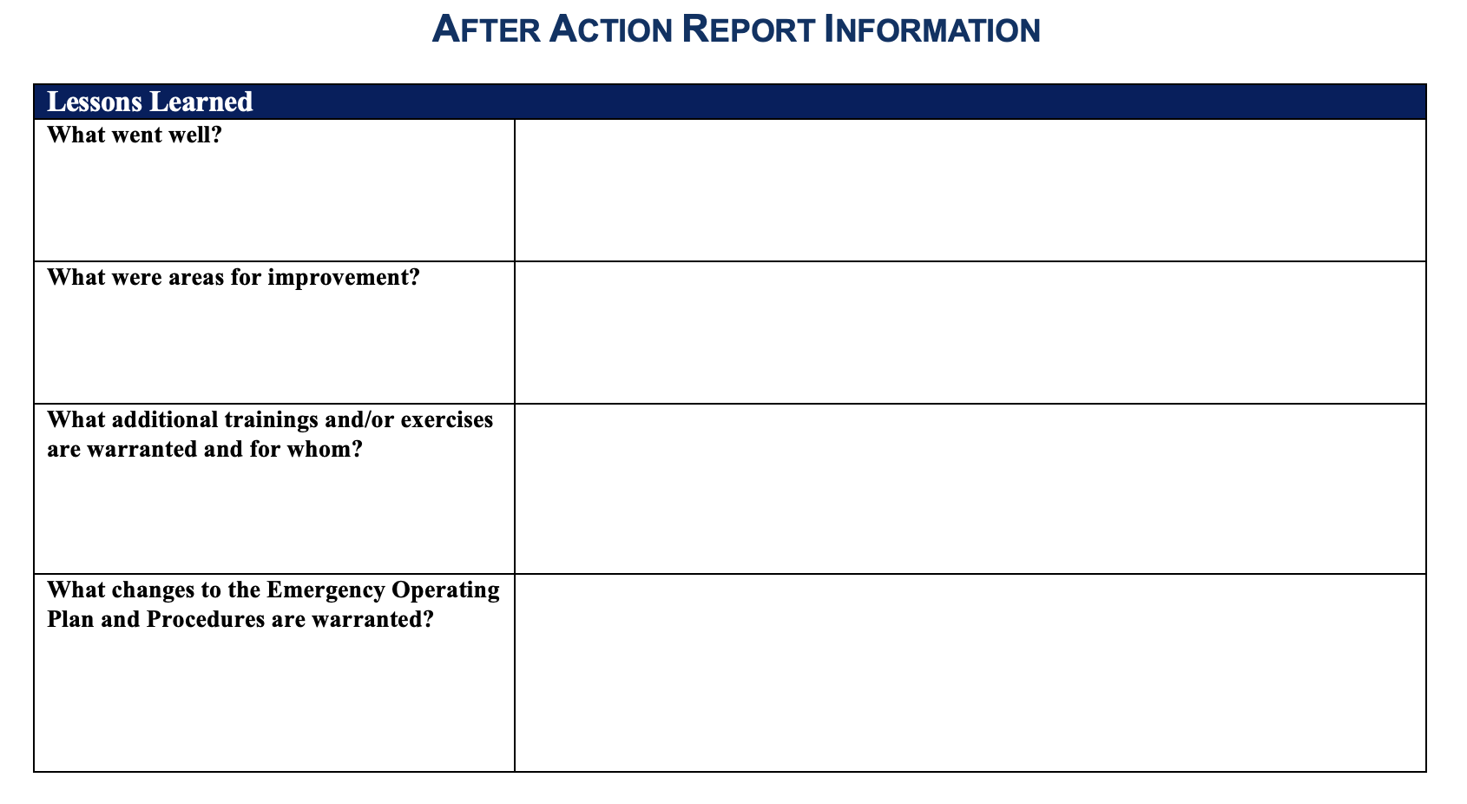
Summary
Notes:
Emma
This is an optional tool that MCSS will share for your school to use if you would like.

Slide 22
Next Steps
Follow-up with exercise invitations, noting that your school participants will be in-person
Confirm location with technology
Test connectivity, camera, speakers, etc.
Establish a “parking lot” to note outstanding issues and topics for future discussion
Optional:
  Conduct an internal onsite Hotwash following the exercise, and/or develop an After-Action Report using the AAR tool
Notes:
Emma

Slide 23
Materials Coming To You
For the facilitator viewing ONLY
The slides from this presentation
A blank summary document for you to use on August 22nd that will include the injects
To share with appropriate personnel
Invite and Information Sheet
Communication samples for after the event
Notes:
Emma

Slide 24
Questions, Comments, & Additional Needs:
?
Thank you for participating!

