Slide 1

Welcome!
Please complete an audio check and put your school’s name in the chat.

Slide 2

Maryland Non-Public School Tabletop Exercise
August 22, 2024
Notes:
Facilitator: Kate/Kim

Slide 3
Exercise Agenda
Time | Activity
12:45 | Meeting room open, tech checks
1:00-1:15 | Opening remarks, MCSS introductions,
1:15-1:30 | Exercise purpose, overview, instructions
1:30-2:00 | Module 1 (30 minutes)
1:30-1:35 | Scenario update
1:35-1:50 | School Discussion
1:50-2:00 | Brief Out
2:00-2:45 | Module 2 (45 minutes)
2:00-2:05 | Scenario update
2:05-2:30 | School Discussion
2:30-2:45 | Brief Out
2:45 | End Exercise
2:45-3:00 | Conclusion, Closing Remarks, Next Steps
Notes:
Facilitator: Emma

Slide 4
Welcome and Introductions
Notes:
Cecilia

Slide 5
Exercise Purpose:
To facilitate internal, on-site discussion that promotes preparedness in non-public schools.
Intended Outcomes:
Support participants in testing existing plans, or identifying areas for future emergency planning
Socialize existing state supports available to non-public schools
Identify non-public school-specific capabilities and needs during emergencies

Slide 6
Exercise Objectives
Help non-public schools to evaluate the effectiveness in responding to and recovering from a significant incident.
Internally identify capabilities and gaps in order to improve plans.
Understand resource and assistance needs in non-public schools, and the ability of the state and other stakeholders to provide support.

Slide 7
Exercise Ground Rules
Short discussion after both module among local groups.
No “right” answers - discuss all options.
Test the plan(s).
Accept the artificialities of the scenario.
Make notes on your responses and be prepared to brief-out to the larger group.
This is a self evaluation opportunity for the school.

Slide 8




Exercise Rhythm
  Scenario Introduction (MCSS Live Stream)
      Breakout: Local Group Discussion
      Brief-out with all groups
    Scenario Update (MCSS Live Stream)
        Breakout: Local Group Discussion
        Brief-out with all groups
  Scenario Introduction (MCSS Live Stream)
      Breakout: Local Group Discussion

Slide 9
Start Exercise

Slide 10

Scenario Introduction: Tornado Watch
Today is Thursday, September 26th. It is a half-day with an early dismissal (12:30 p.m.). Staff have afternoon onsite professional development.
Heavy rain and thunderstorms have been blanketing the area all morning.
11:00 am: The National Weather Service and local weather stations issue a tornado watch for the region.

Slide 11

Discussion

Slide 12
Brief Out
Notes:
Facilitators: Kim to ask Luke/Alex
Emma/Ron (main room)
Steve/Dino (main room)
Don/Kim (Kate)

Slide 13
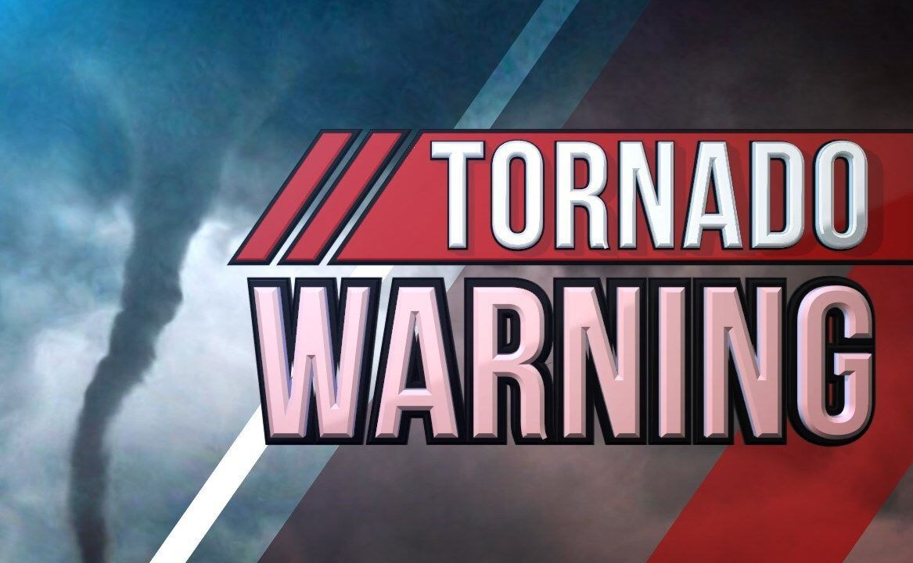
Scenario Update: Tornado Warning
11:45 am: The National Weather Service and local weather stations have upgraded their weather forecast and have now issued a tornado warning until 12:20 pm. The school immediately takes action to ensure student safety.
11:50 am: The school begins to receive calls from concerned parents on what they should do. Some parents are enroute to the school or already in the parking lot. Two buses are also onsite for the early dismissal.

Slide 14
Scenario Update: Tornado Warning
12:05 pm: Staff report a loud train noise passing. Students remain in a secure location while it is confirmed the storm has passed. No students or staff are injured.
12:15 pm: Staff confirm the school building is secure, but a satellite location (portable, gym, or wing of the building) has sustained damage to the roof.
12:30 pm: Students are safely dismissed for the day. Some students’ transportation is late due to debris in the roads.
1:30 pm: It is confirmed that the damaged location will require repair.

Slide 15

Discussion

Slide 16
Brief Out

Slide 17
End Exercise

Slide 18
Feedback, Comments, Questions?
?
Thank you for participating!

Slide 19
Can MCSS provide you with any support?
Contact your regional MCSS staff member:
Dino Pignataro | Anne Arundel, Calvert, Charles, Prince George's, and St. Mary’s Counties | admin.mcss@maryland.gov
Ron Pierce | Anne Arundel, Carroll, Howard, and Montgomery Counties | ronald.pierce@maryland.gov
James Hott | Allegany, Frederick, Garrett, and Washington Co​​unties | james.hott1@maryland.gov
Jeffrey Smith | Kent, Caroline, Talbot, and Queen Anne's Counties​ | Jeffreys.Smith@maryland.gov
Drew Turner | Dorchester, Somerset, Wicomico, and Worcester Counties​ | drew.turner@maryland.gov
Brit Ayers | Baltimore City,​​​ Baltimore County​, Cecil, and Harford Counties | Brittani.ayers@maryland.gov

